Slide 1




SOCCER TRIVIA PRESENTED BY - MADU EVANS

Slide 2

ABOUT PROJECT
My Soccer Trivia project will is an interactive and engaging application designed to test users' knowledge of soccer history, players, teams, and tournaments. The app features multiple difficulty levels—easy, medium, and hard—allowing users to choose a challenge that fits their knowledge. Questions will cover a broad range of topics, from famous players and iconic teams to historic World Cup moments and recent league stats. The application will include a leaderboard to track high scores and encourage friendly competition among users.
To accomplish this, I will develop the application entirely using Python. The back-end will handle user interactions, score tracking, and API integration. I plan on using Python's Flask framework to build the server and integrate an API- football-data.org, to fetch live soccer data and dynamically generate trivia questions. User scores will be stored, and the app will provide a review of the answers at the end of each session. In the future, I aim to enhance the app with additional features, including multiplayer mode, question difficulty customization, and localization for a broader audience. This project will serve as a fun way for soccer enthusiasts to learn more about the sport while honing their trivia skills.

Slide 3
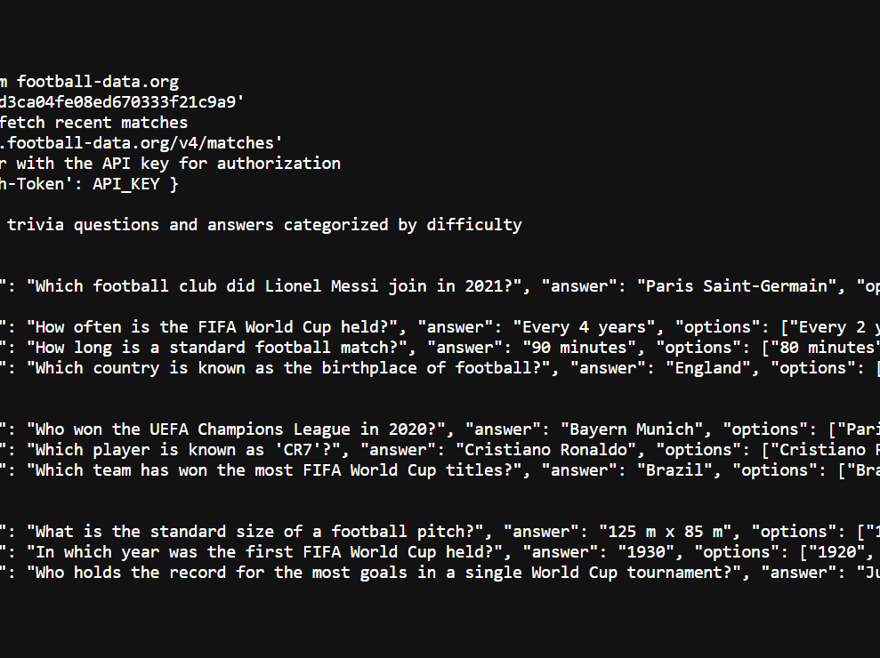
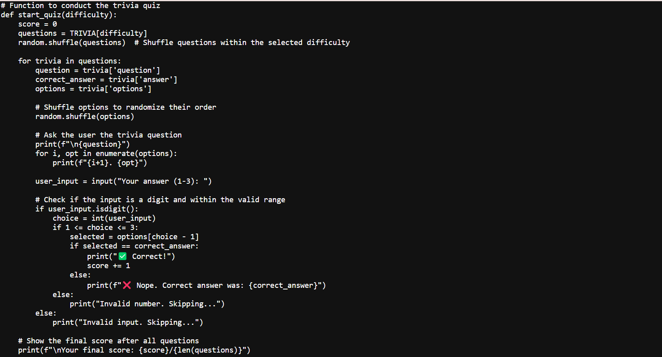
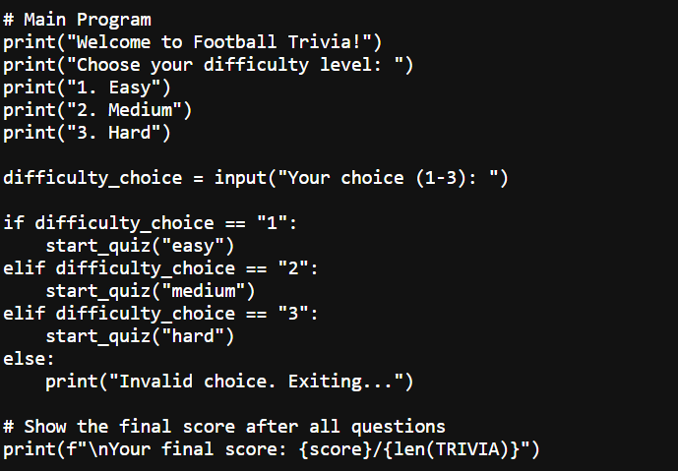
CODE EXCERPT’s

Slide 4
SUMARY OF CODE EXCERPT’s
Image 1 (Top Left): The code organizes football trivia questions into three difficulty levels: easy, medium, and hard, enabling a tailored user experience.
Image 2 (Bottom left): Users select their desired difficulty, and the program dynamically shuffles and presents questions from that category, along with multiple-choice options.
Image 3 (Bottom right): The program evaluates user responses in real-time and displays a final score at the end, fostering engagement and interactivity.

